Slide 1
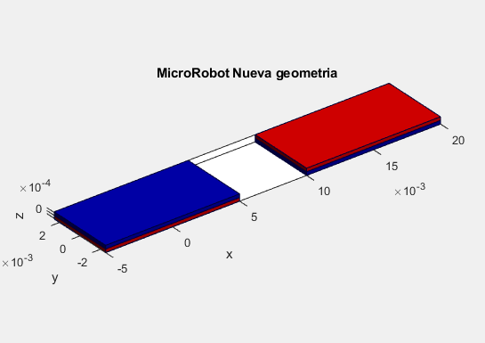
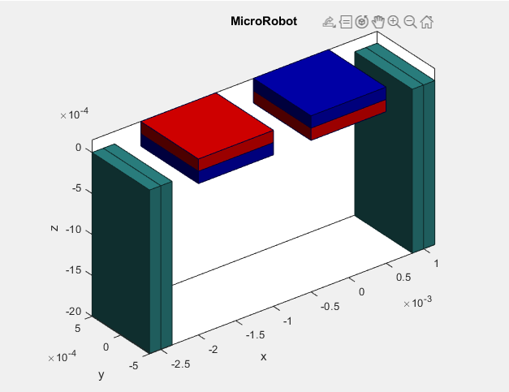
Two magnets of the same geometry
0.5 mm height
5 mm width
10 mm length
Two magnets of the same geometry and two nickel
0.3 mm 0.3 mm height
1 mm 1 mm width
1 mm 2 mm length

Slide 2
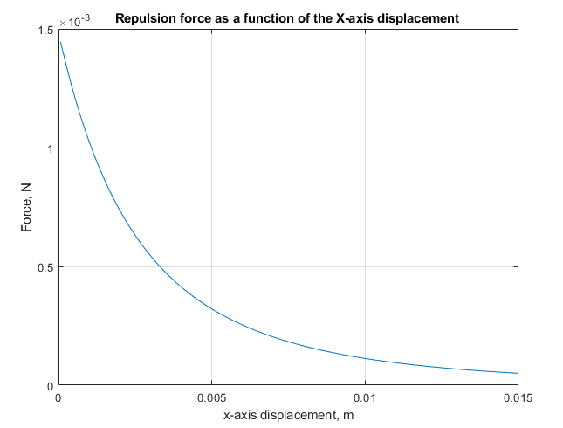
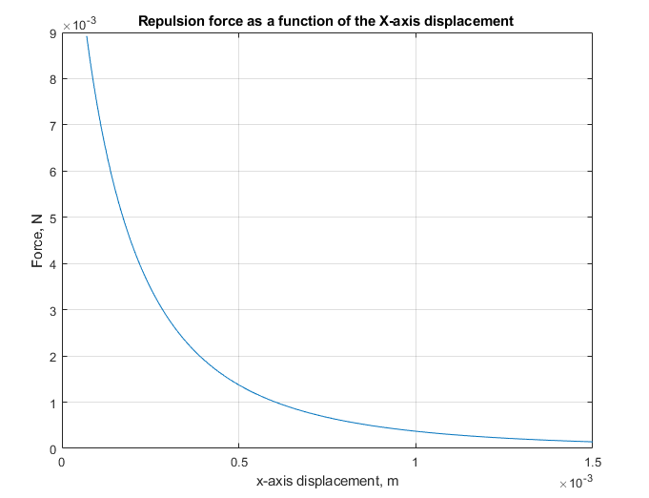

Slide 3
